Slide 1
English Grammar In Use Unit 46 Have Something Done

Slide 2

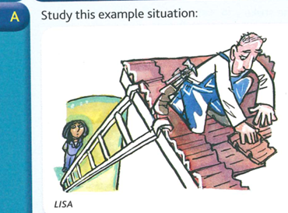
The roof of Lisa’s house was damaged in a storm. So she called a builder, and yesterday a man came and repaired it. Lisa had the roof repaired yesterday. This means: Lisa arranged for somebody else to repair the roof. She didn’t repair it herself.
We use have something done to say that we arrange for somebody else to do something for us.

Slide 3
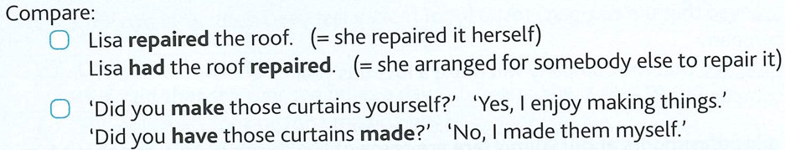

Slide 4
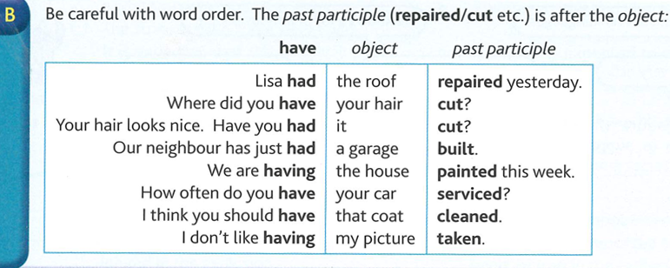

Slide 5
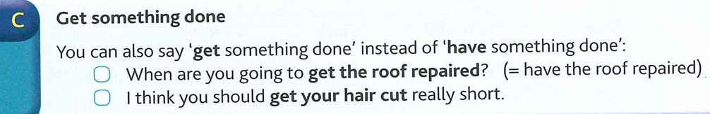

Slide 6
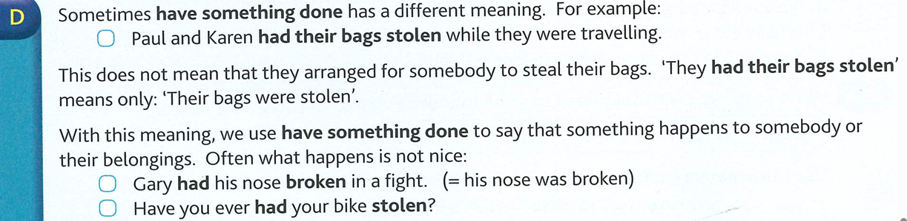

Slide 7
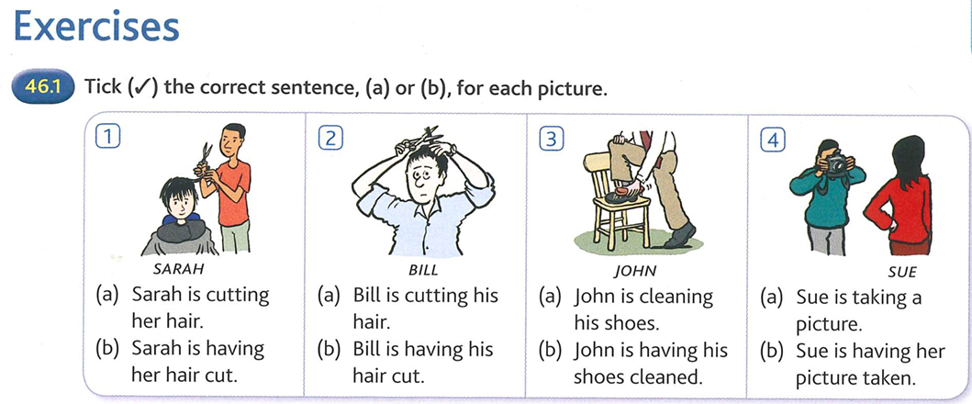
P
P
P
P

Slide 8
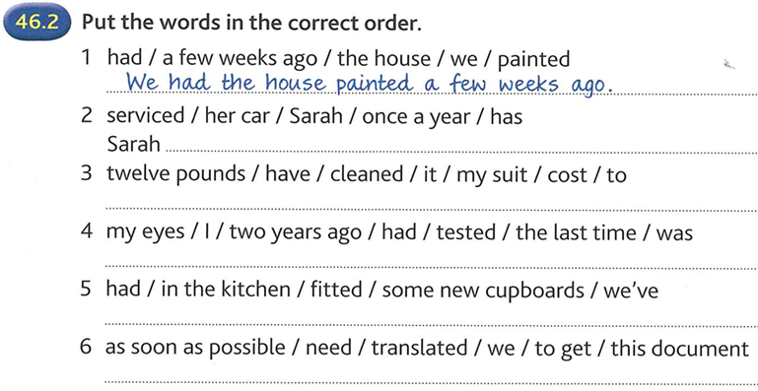
2
has her car serviced once a year.
3
It cost twelve pounds to have my suit cleaned.
4
The last time I had my eyes tested was two years ago.
5
We’ve had some new cupboards fitted in the the kitchen.
6
We need to get this document translated as soon as possible.

Slide 9
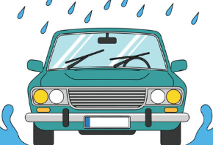
Get your car serviced means:
Take your car to a garage so a mechanic can check it and fix small problems.
They will:
check the engine
check the oil and water
look at the brakes and tyres
look at the windscreen wipers
make sure everything is working well
Tyres are the round rubber parts filled with air on the wheel of most road vehicles.
Windscreen the front window of a car.
Windscreen wipers are long, thin objects on the winscreen of a car. They move from side to side and wipe the windscreen when it’s raining letting the driver see clearly.
Windscreen
Windscreen wiper
Tyre

Slide 10
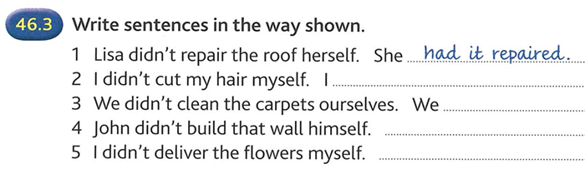
2
had it cut.
3
had them cleaned.
4
He had it built.
5
I had them delivered.

Slide 11

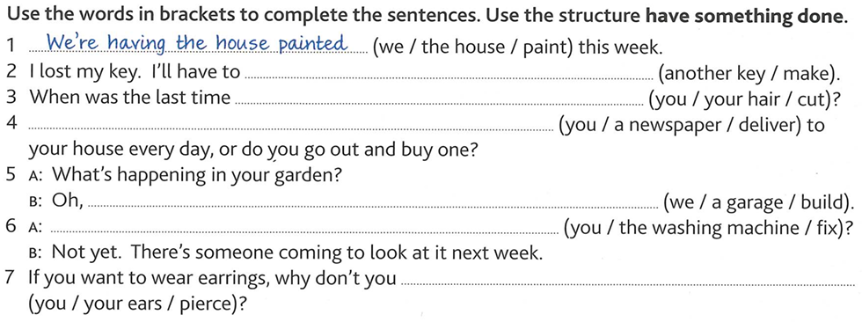
2
have another key made.
3
had your hair cut?
Do you have a newspaper delivered
4
5
we’re having a garage built
6
Have you had the washing machine fixed?
7
have your ears pierced?

Slide 12
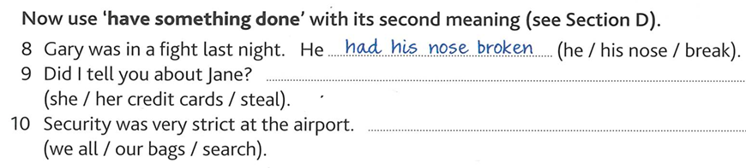
She had her credit cards stolen.
9
We had all our bags searched.
10

Slide 13
Causative get and have
form
Active: The active pattern is
get + sb + to-infinitive, or
have + sb + bare infinitive:
I’ll get my assistant to bring you the other pair of shoes.
Shall I have my secretary send you the details?
Passive: The passive pattern is
get/have + object + past participle:
I’m getting/having my house decorated at the moment.
You ought to get/have your blood pressure checked.

Slide 14
Use
Causative get and have mean ‘ask or cause somebody to do something’ in the active form, and ‘arrange for somebody else to do something’ in the passive.
Get is more common in British English.
Have is now more formal except in some situations described below.

Slide 15
Sometimes causative get/have suggests the need to deal with a difficulty:
I’m afraid you'll have to get/have the whole house rewired.
We use have in the passive when something unpleasant, happens.
Get is much less common than have in these situations:
I had my wallet stolen in the crowd.
He had his car broken into last night.
Sometimes when we use have, meaning depends on context:
We’ve had the bricks removed.
(= either we arranged for somebody to take them, or somebody stole them)
We use get, not have, when somebody else has to work on our behalf:
One of these days I’m going to get myself elected onto the committee.

Slide 16

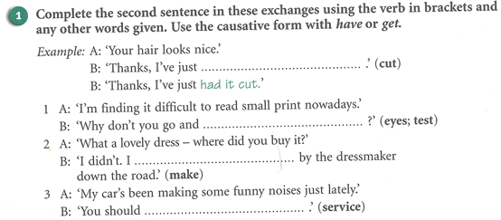
Come, go, stop and try are often followed by and and the infinitive without to. See Ex 1.
1
get your eyes tested
2
got it made
3
get it serviced

Slide 17
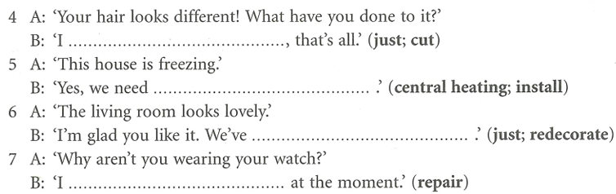
4
just got it cut
5
to get central heating installed
6
just had it redecorated
7
’m getting it repaired

Slide 18
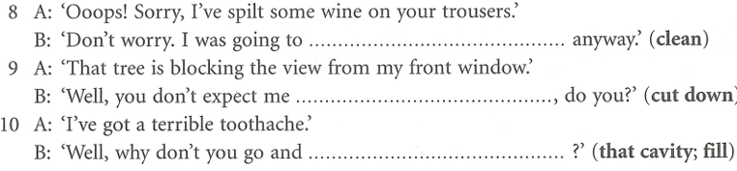
8
get them cleaned
9
get it cut down
10
get that cavity filled.

